Slide 1
Shield Row Primary School
A guide to Phonics and Reading Development
Phonics has been widely recognised and accepted as the first and most significant strategy in the process of reading development. This guide is designed to give a brief overview of why and how we teach phonics at Shield Row and how parents can support this teaching at home.

Slide 2
Why phonics?
Phonics teaches children to listen carefully, differentiate between sounds and recognise the phonemes (sounds) that make up each word. Learning the phonemes and the corresponding grapheme (written form) is the basis for learning to read and spell words.
At Shield Row Primary School the teaching of phonics is approached in an engaging fun way for all the children. Phonic sessions are composed of games, music,
stories, songs and actions. We concentrate mainly on the first phase of phonic
teaching (Phase 1). This phase focuses on developing children's speaking and listening skills, and continues throughout the year.
Phase 1
The emphasis during Phase 1 is to get children attuned to the sounds around them and ready to begin developing oral blending and segmenting skills. Recognising and identifying sounds in the environment, voice sounds, sounds that are produced from musical instruments and body percussion form the basis of the learning. This together with emphasis on teaching rhyme, rhythm,beat and alliteration give the children the skills to confidently move onto the next phase. Phase 1 consists of the following aspects:
Aspect 1 General sound discrimination - environmental
The aim of this aspect is to raise children's awareness of the sounds around them and to develop their listening skills. Activities include going on a listening walk, drumming on different items outside and comparing the sounds, playing a sounds lotto game and making shakers.
Aspect 2 - General sound discrimination - instrumental sounds
This aspect aims to develop children's awareness of sounds made by various instruments and noise makers. Activities include comparing and matching sound makers, playing instruments alongside a story and making loud and quiet sounds.
Aspect 3 - General sound discrimination - body percussion
The aim of this aspect is to develop children's awareness of sounds and rhythms. Activities include singing songs and action rhymes, listening to music and developing a sounds vocabulary.
Aspect 4 - Rhythm and rhyme
This aspect aims to develop children's appreciation and experiences of rhythm and rhyme in speech. Activities include rhyming stories, rhyming bingo, clapping out the syllables in words and odd one out.

Slide 3
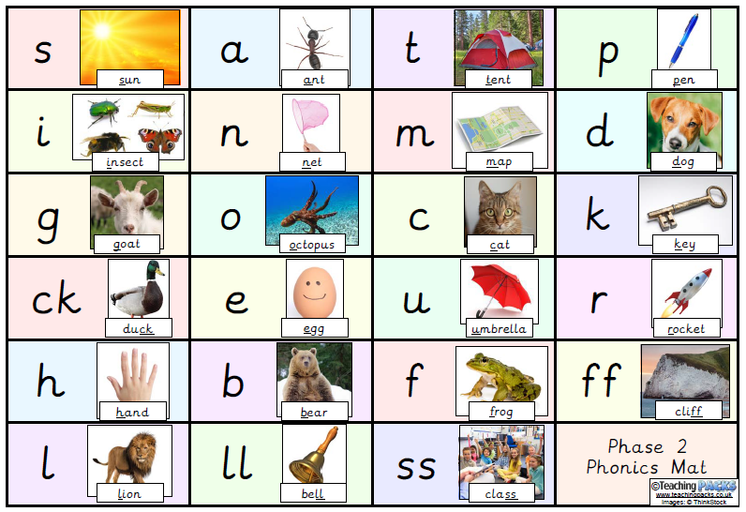
Aspect 5 - Alliteration
The focus is on initial sounds of words, with activities including I-Spy type games and matching objects which begin with the same sound.
Aspect 6 - Voice sounds
The aim is to distinguish between different vocal sounds and to begin oral blending and segmenting. Activities include Metal Mike, where children feed pictures of objects into a toy robot's mouth and the adult sounds out the name of the object in a robot voice - /c/-/u/-/p/ cup, with the children joining in.
Aspect 7 - Oral blending and segmenting
To practise oral blending, the adult could say some sounds, such as /c/-/u/-/p/ and see whether the children can pick out a cup from a group of objects. For segmenting practise, the adult could hold up an object such as a sock and ask the children which sounds they can hear in the word sock.
Phase 2
This is the phase where we introduce letters in a set order. We encourage children to make the link between the sound and the letter shape. Once the children have been introduced to several sounds they can then begin to sort objects using the initial sound as a prompt. It is important at this stage to say each sound correctly.
(refer to weblinks for guidance)

Slide 4
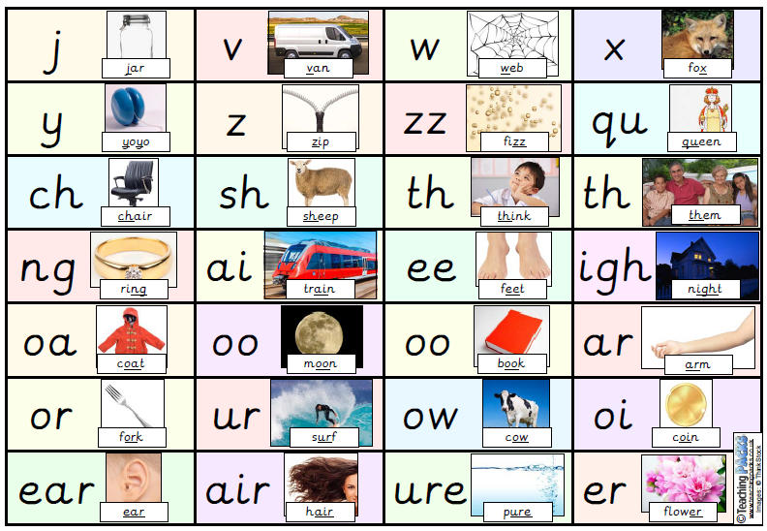
Phase 3
This is the phase where we introduce the children to consonant digraphs and vowel digraphs (2 letters that make 1 sound). By this point, children should be able to segment and blend words to read them. words, including ‘me,’ ‘was,’ ‘my,’ ‘you’ and ‘they’. They learn the names of the letters, as well as the sounds they make.
By the end of phase 3, the children should be able to say the sound made by most, or all, Phase 2 and 3 graphemes, blend and read CVC words made from these graphemes, read the tricky words and write letters correctly when given an example to copy.
Phase 4
By now, children should be confident with each phoneme. From here on, phonics teaching is about consolidating and refining their knowledge, introducing more spelling patterns and tricky words, and increasing vocabulary,
In Phase 4 phonics, children will, among other things:
Practise reading and spelling CVCC words (‘bump', 'nest', ‘belt,’ ‘milk’, etc)
Practise reading and spelling high frequency words
Practise reading and writing sentences
Learn more tricky words, including ‘have,’ ‘like,’ ‘some,’ ‘little’
Children should now be blending confidently to work out new words. They should be starting to be able to read words automatically, rather than having to sound them out. Children should also be able to write every letter, mostly correctly.

Slide 5
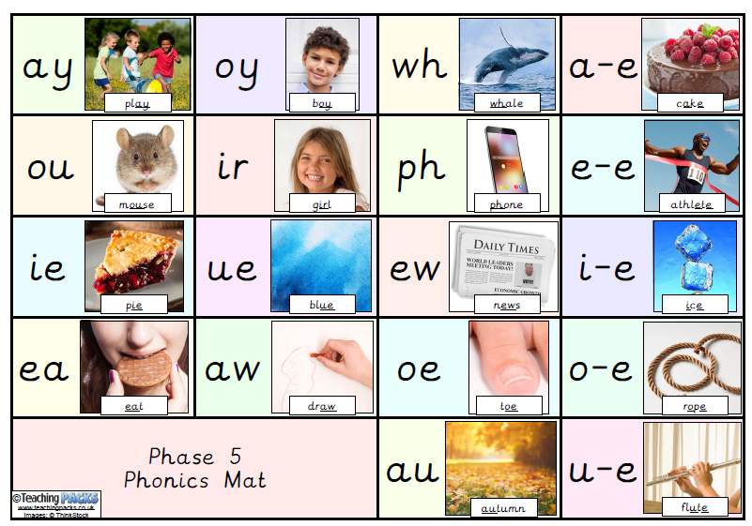
Phase 5
Phase 5 generally takes children the whole of Year 1. This is where we start introducing alternative spellings for phonemes such as 'igh’. The children master these in reading first, and as their fluency develops, we begin to see them using them correctly in spelling.’
Children learn alternative graphemes (different ways of spelling each phoneme) and alternative pronunciations for these: for example, learning that the grapheme ‘ow’ makes a different sound in ‘snow’ and ‘cow’.
Children should become quicker at blending, and start to do it silently. They learn about split digraphs such as the a-e in ‘name.’
Children will start to choose the right graphemes when spelling and will learn more tricky words, including ‘people,’ ‘water’ and ‘friend’. They also learn one new phoneme: /zh/, as in ‘treasure.’
By the end of Year 1, children should be able to:
Say the phoneme for any grapheme they are shown
Write the common graphemes for any given phoneme (e.g. ‘e,’ ‘ee,’ ‘ie,’ ‘ea’)
Use their phonics knowledge to read and spell unfamiliar words of up to three syllables
Read all of the 100 high frequency words, and be able to spell most of them
Form letters correctly
At the end of Year 1, all children are given a Phonics Screening Check to ensure they have mastered the appropriate knowledge.

Slide 6
Phase 6
Phase 6 phonics takes place at the beginning of Year 2, with the aim of children becoming fluent readers and accurate spellers.
By Phase 6, children should be able to read hundreds of words using one of three strategies:
Reading them automatically
Decoding them quickly and silently
Decoding them aloud
Children should now be spelling most words accurately.
Through phase 6, children will also learn, among other things:
Prefixes and suffixes, e.g. ‘in-’ and ‘-ed’
The past tense
Memory strategies for high frequency or topic words
Proof-reading
How to use a dictionary
Where to put the apostrophe in words like ‘I’m’
Spelling rules
Although formal phonics teaching is usually complete by the end of Year 2, children continue to use their knowledge as they move up the school. The whole aim of phonics teaching is not just to learn the phonemes, but to use them as a tool for reading and spelling. Everything leads on to independent reading and writing.

Slide 7
Activities to support phonics learning at home
The following list gives a flavour of the type of activities that can be carried out at home to support your child in developing their phonic knowledge and awareness. The list
of weblinks give a more extensive range of ideas and interactive activities.
Listening Walk Go on a walk indoors or outdoors see how many sounds can be heard. List them pictorially.
Guess the object Choose household objects that make a sound e.g. bunch of keys, squeaky toy or instruments.
Explore the sounds then make the sound with the object behind a screen. Can your child guess the object?
Grandmother’s footsteps Choose a range of objects / instruments to produce
different sounds. Match a type of footstep e.g. tiptoes, fairy steps, giant stamps, hops
etc. Play the instrument hidden behind back and see if child can respond with correct
movement.
Shaker Maker Make shakers with different contents to produce a range of sounds.
(Plastic bottles with lids ) Put hand puppets over the shakers to hide the contents.
Shake to see if child can guess the contents.
Rhythm and Rhyme Sing / say nursery rhymes, read rhyming stories and stories with a repeated rhythmical phrase e.g .the Gingerbread man
Listen to The Beat Clap/ stamp a rhythm / pattern and ask your child to copy it. Use
a variety of percussion instruments to play different rhythms and move in time by marching/ stamping or clapping along.
Playing with words This activity focuses on names and names of objects. The idea is to explore the name of an object or person by clapping the syllables. Encourage your child to clap along when you say the word.
www.letters-and-sounds.com/phase-1-games.html
www.phonicsplay.co.uk/Phase1Menu.htm
www.letters-and-sounds.com/phase-1-resources.html
www.earlylearninghq.org.uk/literacy/letters-sounds/
www.oxfordowl.co.uk/for-home/reading-owl/expert-help/phonics-made-easy
www.topmarks.co.uk/interactive.aspx?cat=139

